Slide 1

TASK 2 Design and Implementation of a Road Sign and Road State Mobile Notification Application
GROUP 15
1

Slide 2
TABLE OF CONTENTS
01
02
03
INTRODUCTION
REASONS FOR REQUIREMENT GATHERING
REQUIREMENT GATHERING FOR OUR PROJECT
04
05
06
REQUIREMENT GATHERING TECHNIQUES WE USED
CONCLUSION
OUR TEAM
2

Slide 3
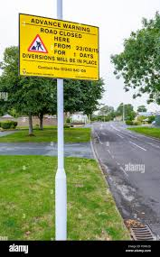
INTRODUCTION
Leveraging technology to provide real time update of road state and road signs to drivers

Slide 4
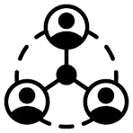

REASONS FOR REQUIREMENT GATHERING
Ensure stakeholder alignment
Reduces the risk of project failure
Addresses Regulatory Concerns
Requirement gathering uncovers any legal or regulatory requirements related to the app's functionality
ensure that everyone is on the same page about what the system needs to do and how it should work
project failure, wasted resources, and damage to the reputation of the development team

Slide 5

REQUIREMENT GATHERING FOR OUR PROJECT
Understanding Driver Needs
Ensuring Road Safety
Developing a User-Friendly Interface

Slide 6
Requirement Gathering Techniques we used
User Interviews
Surveys
User Reviews of existing systems
Brainstorming

Slide 7
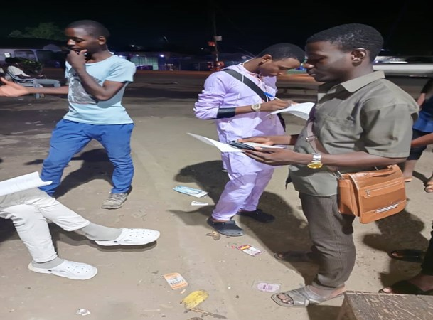
Inteviews
What are the biggest difficulties you face regarding road signs while driving?
How do you currently stay informed about traffic conditions and road closures?
What features would be most helpful in a mobile application for road signs and road state information?

Slide 8
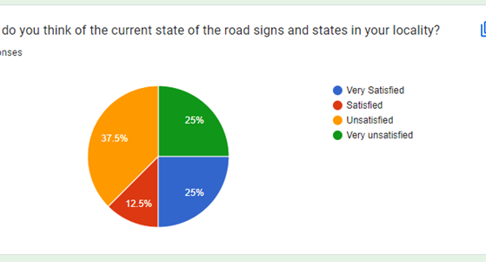
Surveys
How often do you encounter unexpected road signs or changes in road conditions while driving?
Would you be interested in receiving notifications for specific types of road signs (e.g., stop signs, speed limit changes)?

Slide 9
Requirements gathered (Method used)
Location-Aware Information and Navigation (Research)
Traffic Light and Sign Detection (Brainstorming)
Pedestrian Detection (Interview)

Slide 10
Requirements gathered (Method used)
Requesting Help and Crash Detection (Interview)
User Reporting (Brainstorming)
Route Planning (Survey)

Slide 11
Requirements gathered (Method used)
Security and Privacy (Survey)
Offline Functionality (Interview)
Usability (Research)

Slide 12

MAJOR CHALLENGES

Slide 13

THANK
YOU!!!!!

